Slide 1

Sample Equity Research
By Xerxes Chong Xian
MEng Aeronautical Engineering
Imperial College London, Class of 2021

Slide 2

Analysis of
Micro-Mechanics (SGX: 5DD)
Data accurate as of 30/10/2018

Slide 3
Investment Tenets Applied
Business Tenets
Can we understand the business
Management Tenets
Who are the stewards of the business
Financial Tenets
Does the business add value for its shareholders
Valuation Tenets
An unfair price for a great business, is still a bad investment

Slide 4
Investment Tenets
Business
Management
Financial
Valuation
Have an easy to understand business mode
Consistent and profitable operating history
Have favorable long term prospects
Does the management make rational decision
Are they honest and candid about failures and successes
Do they own a stake in the business
Does the business generate high ROE
Does it have consistent growth in earnings
Consistent and increasing Cash from OPS and CAPEX
Robust Balance sheet
Is it over/undervalued relative to its industry and market
What is the level of institutional ownership and analyst coverage
Low/High Dividend payout policy
Can you profit on this price

Slide 5


Business Tenets
Does the business…
1
Have a simple and easy to understand model
2
Have a consistent and profitable history
3
Have favorable long-term prospects

Slide 6
Business Tenet: Simple and Easy to understand
Design and manufacture
high precision parts, tools
Consumables
For assembly and testing of semi-conductors
Contract manufacturing for semi-conductor wafer-fabrication and other high technology industries
Revenue is split into 2 product segments
Semiconductor tooling
Custom Machining and Assembly (CMA) Division

Slide 7
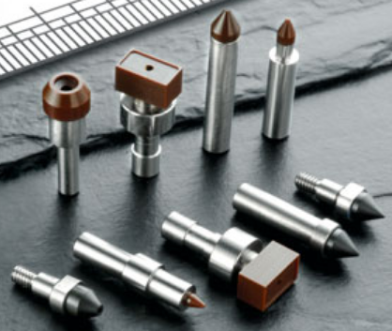
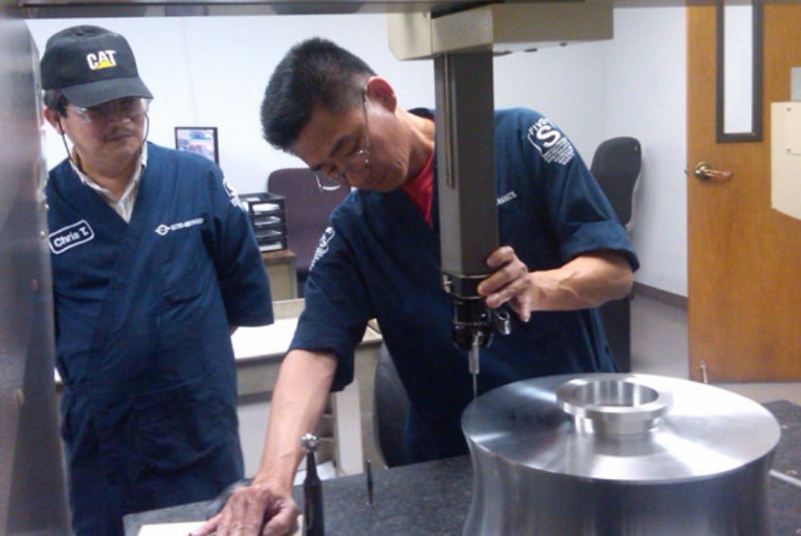
Business Tenet: Simple and Easy to understand
Consumable products include
Plastic pick-ups
Collets
Ejector Needles
Clamps
Nozzles
CMA Division manufactures on contract basis to OEMs in;
Aerospace
Semi-conductor
Laser
Medical

Slide 8
Business Tenet: Simple and Easy to understand
Strengths | Weaknesses
Low customer concentration risk Largest contributor of revenue stood at 7% at time of IPO, amongst a customer base of 200 | Volatility in cost and supply from commodities market Reliance on raw materials such as plastic, steel, rubber and aluminium
Likely to have constant stream of business Main products being consumables Forms small portion of it’s customers spending | Operates in the highly cyclical semiconductor industry. Dependent on demand for end-user applications such as consumer electronics and high-tech equipment
No direct competitors for Group’s entire line of products Smaller companies and workshops can compete in some tools but lack the resources to compete on flexibility and scalability | Large non-cash depreciation costs Asset heavy business

Slide 9
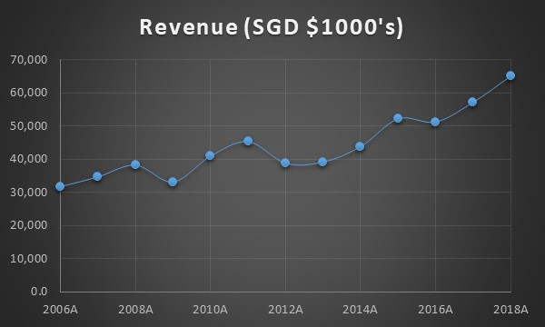
Business Tenet: Consistent and Profitable History
- Revenues have grown steadily at a CAGR of 5% for the past 10 years

Slide 10
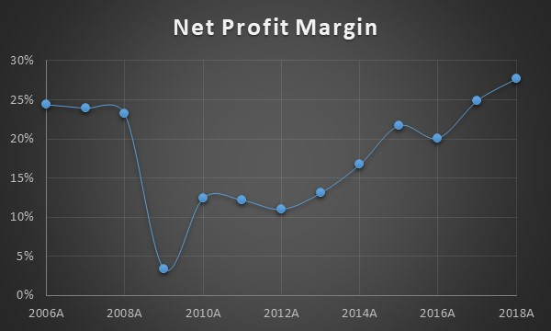
Business Tenet: Consistent and Profitable History
- Net Profit Margins improved since the GFC due to Group’s successful implementation of cost-cutting measures

Slide 11
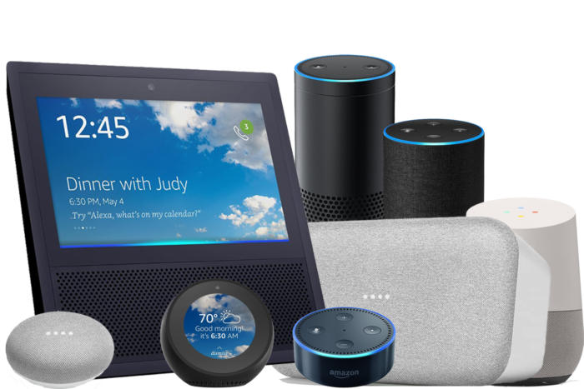
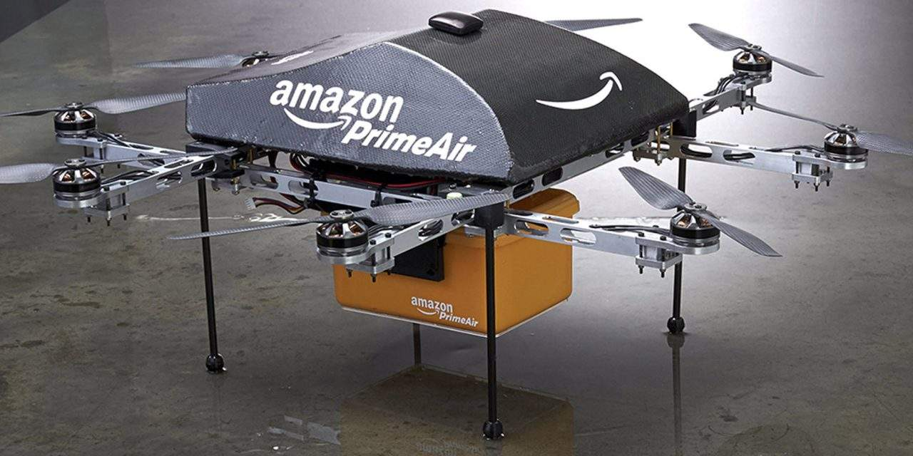
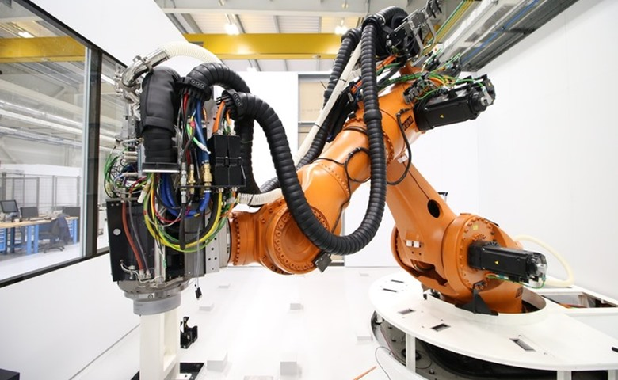
Business Tenet: Favourable Long-term prospects
Secular trend of proliferation of electronics into everyday life such as but not limited to;
Rise of FinTech
Proliferation of drone technology
Internet of Things (Smart devices, sensors)
Autonomous vehicles
Automation of various industries
All form of electronics will require the use of semiconductors and it’s ancillary products in its products and infrastructure
Such trends will underpin long-term growth and demand for the industry the Group operates in

Slide 12
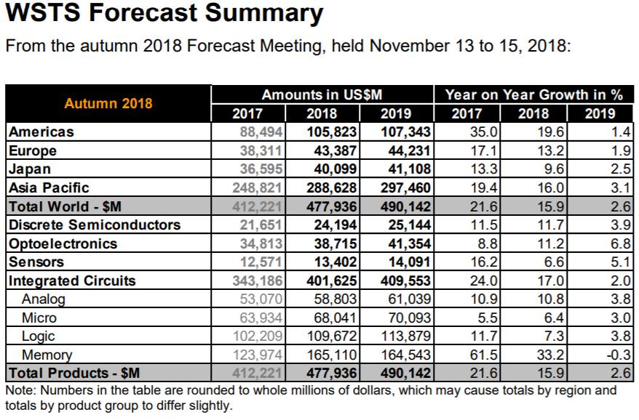
Business Tenet: Favourable Long-term prospects
- Slow down from double digit Year on Year Growth in 2017 and 2018 to 2.6% in 2019
- Projected slowdown in the cyclical industry forecasted by WSTS;
Present undervalued situations for superior companies due to overall devaluation of industry

Slide 13
Management Tenets
Does the management…
1
Make rational decisions
2
Communicate honestly with shareholders
3
Own a stake in the business

Slide 14
Management Tenets: Rational decision makers
Delivered on promises to cut cost and debt
Net profit margins grown at CAGR of 16% while Cost of Goods Sold have grown at CAGR of 6% for the past 10 year
Zero bank borrowings and healthy cash balance for past 10 years
Delivered on promises to reduce headcount
Head count decreased 28% from FY2011 following investments in I.T. and other P.P.E
People-focused and willing to invest in human capital
Extended employment to employees of acquired businesses
Employee Exchange Programmes
Management Workshops

Slide 15
Management Tenets: Rational decision makers
“cost cutting, if done poorly, could jeopardize our standing with customers and diminish the value of the know how…”
̶ Management on cost cutting
“They immediately provide us the skills and know-how that could have taken us many years to develop”
̶ Management on the decision to extend employment to employees of an acquired business
“This approach frees us from the burden of covering interest costs and the sometimes-unhealthy pressure that debt can place on management”
̶ Management on ensuring zero debt

Slide 16
Management Tenets: Honesty with shareholders
Trumpets their failures as loud as their accomplishments
Invested resources to establish a CMA business in the USA in FY2006 which turned unprofitable
Multi-million dollar automated machining facility
Transparently announced in FY2016 to exit business and stick to their circle of competence
Management was also transparent in its decision to close subsidiaries in Switzerland and Thailand.

Slide 17
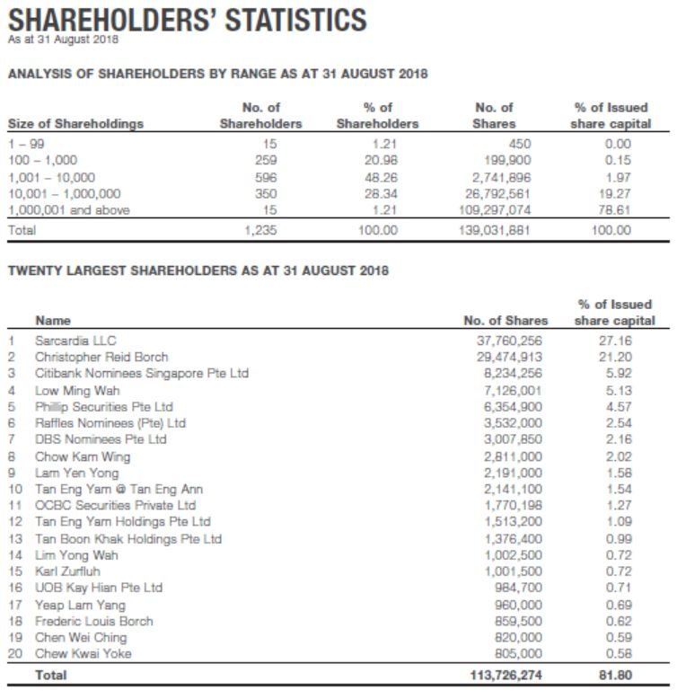
Management Tenets: Own a stake in the business
55.51% ownership by management ensures an alignment of interest with shareholders.
CEO/Founder Mr Christopher Reid Borch own a combined 48.36% of the Group through Sarcardia LLC
Combined with the stake held by Mr Low Ming Wah(President, COO) and Mr Chow Kam Wing (CFO), management holds a combine stake of 55.51%.

Slide 18
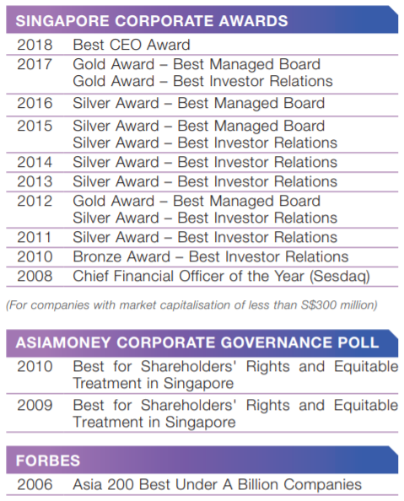
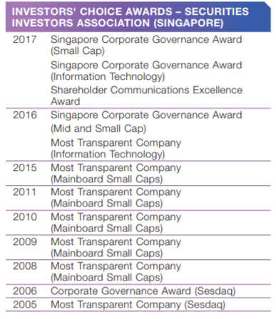
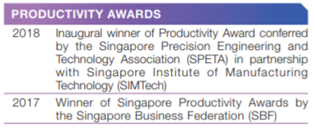
Management Tenets
Superior management is well recognised…

Slide 19
Financial Tenets
Does the business…
1
Generate high Return on Equity
2
Consistent Earnings Growth
Consistent and increasing Cash Flow from Operations and Free Cash Flow
3
4
Have a robust balance sheet

Slide 20
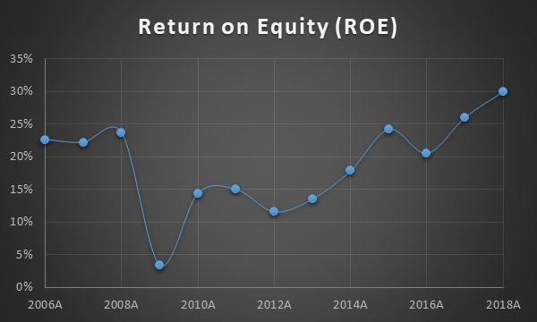
Financial Tenets: High Return on Equity (ROE)
ROE has grown from 15% in FY2018 to 30% in FY2018
Coincides with the Groups efforts to boost productivity and efficiency through cost cutting measures and implementation of IT

Slide 21
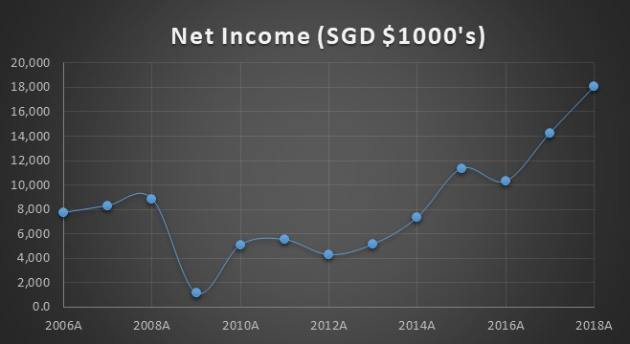
Financial Tenets: Consistent Earnings Growth
Net income has made an impressive recover from FY2009
Coincides with the Groups efforts to boost productivity and efficiency through cost cutting measures and implementation of IT

Slide 22
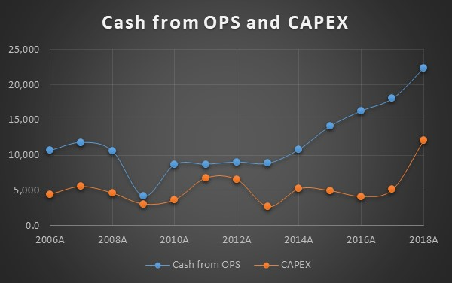
Financial Tenets: Consistent Free Cash Flows
Operating Cashflows have always exceeded CAPEX, generating consistent Free Cash Flows
Operating Cashflows have also increased while CAPEX stayed relatively consistent

Slide 23
Financial Tenets: Robust Balance Sheet
SGD($1000’s) | FY14 | FY15 | FY16 | FY17 | FY18
Current Assets | 23,778 | 28,838 | 33,691 | 38,998 | 37,564
Non–current Assets | 27,157 | 26,918 | 25,644 | 26,586 | 35,726
Current Liabilities | 8,539 | 7,527 | 7,545 | 9,137 | 9,623
Non–current Liabilities | 1,283 | 1,547 | 1,344 | 1,686 | 3,362
Current Ratio | 2.78 | 3.83 | 4.47 | 4.27 | 3.90
Total Ratio | 5.19 | 6.14 | 6.68 | 6.06 | 5.64
Net Gearing Ratio | 0.03 | 0.13 | 0.22 | 0.23 | 0.13
Operating Cashflows have always exceeded Capex, generating consistent Free Cash Flows
Operating Cashflows have also increased while CAPEX stayed relatively consistent
Notes:
Total, current and Net gearing ratio shows a very robust balance sheet

Slide 24
Valuation Tenets
Does the business…
1
Have high/low P/E ratio relative to industry and the market
2
Level of institutional ownership and analyst coverage
3
Low Dividend Payout ratio
4
Provide satisfactory returns at current price

Slide 25
Valuation Tenets: P/E ratio relative to industry
Company | Business | P/E ratio
Global Testing | Testing for semiconductor manufacturing industry | 6.54
Avi Tech | Burn-In Services, Manufacturing and PCBA Services, and Engineering Services | 8.27
Sunright | Semiconductor testing and burn-in services. | 8.26
UMS | Semiconductor components, and electromechanical assembly and final testing services | 7.21
Ellipsiz | Manufacturer and distributor of semiconductor equipment | 9.43
Elec and Eltek | Manufactures high density interconnects and backplane printed circuit boards (PCB) | 7.13
CEI | Manufacturer of Printed Circuit Board Assembly (PCBA ) , Box Build and Equipment Manufacturing | 11.95
Micro-Mechanics | Designer and manufacturer of high precision parts, tools and consumables | 13.48
Singapore Industry Average |  | 9.03

Slide 26
Valuation Tenets: P/E ratio relative to industry
 | P/E ratio
Singapore Industry Average | 9.03
SPDR Straits Times Index ETF (ES3.SI) | 11.26
Micro-Mechanics | 13.48
Group’s share trades at a premium to both the Singapore industry average and the Singapore market.
No available P/E ratio for the semiconductor industry in Singapore.
P/E ratios of peer companies operating in similar product lines and services were used to obtain an industry average
Notes:
Due to the cyclical nature of the business, the DCF valuation is unsuited for valuation.
After scouring through the research reports from DBS Vickers and Phillip Securities, there is currently no accurate P/E ratio for the businesses involved the semiconductor industry in Singapore. Hence an average of the latest P/E ratios of peer companies available on the POEMS platform were used to obtain an industry average P/E ratio.

Slide 27
Valuation Tenets: Institutional Ownership, Analyst Coverage, Dividend Payout
- Low levels of institutional ownership
Only a single brokerage providing research coverage on Group
FY2018 recorded a high level of dividend payout at 81%
Notes:
-Low levels of institutional ownership is ideal as the announcement of vested interest in a small cap stock can be a strong catalyst for the share price growth as the public will be keen to “jump on the bandwagon”, to follow the movement of smart money. As big funds have a minimum market cap on their investment, most institutional interest will appear when the Group has attained a sufficiently large market cap. Once this has happened and provided the Group is still attractive as an investment, institutions will begin buying up shares, driving up the share price.
-Low levels of analyst coverage is also ideal as the eventual “discovery” and release of more analyst reports by different brokerage firms can act as a strong catalyst for the share price
- I would have preferred to see a lower dividend payout, with the money being spent on CAPEX. When the business is large enough and CAPEX requirements have decreased, the distribution of excess capital to dividends will spike the dividend yield, drawing higher valuations and attracting institutional investors and income investors.

Slide 28
Valuation Tenets: Satisfactory returns at $1.74
Super conservative
CAGR of EPS | 3%
2 Year Forward EPS (cents) | 13.77
2 Year Forward Valuation (SGD) | 1.24
CAGR of Valuation | -0.11
CAGR of Share Price | -8%
Take Profit (SGD) | 1.478
Conservative
CAGR of EPS | 7%
2 Year Forward EPS (cents) | 14.95
2 Year Forward Valuation (SGD) | 1.68
CAGR of Valuation | -1%
CAGR of Share Price | 6%
Take Profit (SGD) | 1.965
A super conservative and conservative valuation was performed using a 2 year forward EPS.
The CAGR of EPS was pegged to the long-term inflation rate of Singapore at 3% in the super conservative valuation
The CAGR of EPS was pegged to the 10 year CAGR of EPS for the Group in the conservative valuation
Notes:
The valuation method of CAGR of Share Price = CAGR of Valuation × CAGR of Earnings (EPS) was used
2 Year Forward EPS = Current EPS(1+CAGR of EPS)^2
2 Year Forward Valuation (super conservative)= (2 Year Forward EPS)* (Singapore Industry Average)
2 Year Forward Valuation (conservative)= (2 Year Forward EPS)* (10 year CAGR of EPS for Group)
As we can see from both cases, the main driver of share price for the Group will be it’s superior earnings and not the changes in it’s valuation ( as it is overvalued at this current P/E ratio)

Slide 29
Valuation Tenets: Satisfactory returns
What price should a fund pay to obtain a return that exceeds the MSCI World Small-Cap index by 3% per annum (19.21%)
Target Price : SGD1.38
Take Profit : SGD1.96
If the price of the Group’s shares falls to SGD1.38 and below, and assuming the Group’s circumstance has not altered from this analysis, there is a potential upside of 19.21% annualized return
Notes:
The annualized 10 year return of the MSCI World Small-Cap index fund is currently at 16.21% at of February 28, 2019. If we are to beat this return by 3% per annum, an entry price of SGD1.38 will be ideal to obtain the desired annualized return after 2 years.

Slide 30
-Long term prospects for steady growth, despite cyclical nature
1
2
- Honest and capable management who are prudent allocators of capital
- Proven themselves in the financial crisis
Summary
3
- Healthy balance sheet that can take on more debt if needed
4
-Room for higher valuations
- Current share price reflects the high valuation

Slide 31
Thank You

